Slide 1
Driver Drowsiness Detection System
A neural network combined with a facial feature extraction module
Team 6
Team members: Tianhan Jiang, Peiyun Zhao, David Laditan, David Guo, Tobi Lawal
Mar 12, 2021

Slide 2
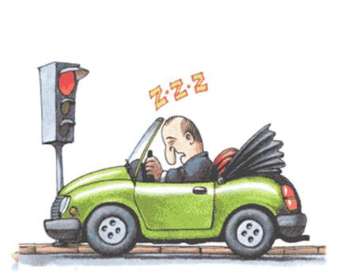
Background - Problem
Drowsy Driving Annually causes:
100,000 vehicle crashes
1,500 deaths
$12.5 billion monetary loss
20% drivers on the road show signs of drowsiness
Notes:
As previously discussed in our midterm we are determined to use deep learning to help the issue of drowsy driving. Annually, Drowsy driving causes, 1 hundred thousand crashes, 15 hundred deaths and 12.5 billion dollars worth of damages. Statistically 20% of the drivers also show signs of drowsiness.
This project aims to combine a fine-tuned neural network and a python-based face detection and feature extraction module into a real-time drowsiness detection system that will contribute to improving road safety.

Slide 3
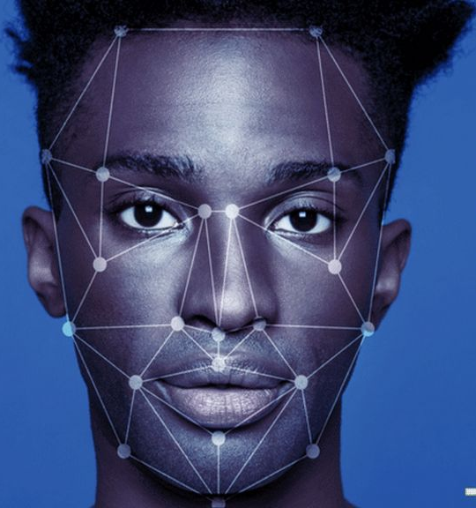
Solution
Current facial expression recognition limits:
75-80% Accuracy
Performance Accuracy
Acceptable: >70%
Outstanding: 75-80%
Notes:
Previously we have set our model performance criteria at 75%-80%, current facial expression recognition limits. However we have since achieved much higher on our Driver Drowsiness detection, we theorize that this is largely due to the simplicity of identifying drowsiness state rather than more complex expressions.

Slide 4
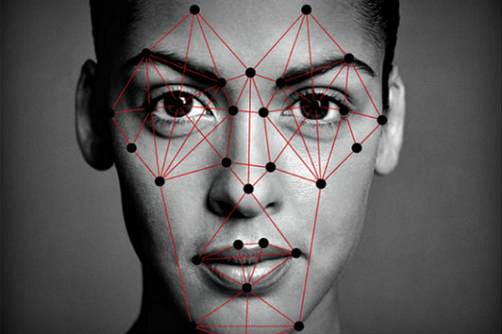
Facial Feature Extraction Module
Data pre processing
extract facial regions
Notes:
We have implement a python-based module to preprocess all images from the training set, validation set, and test set. This module will be used to perform facial recognition first, keeping only the facial region of the image.
This module will also contain algorithms to extract eye regions and mouth regions separately. For the training set and validation set, either eye feature extraction or mouth region extraction functionality will be used to keep only the region that matches the label. For the test set, or real-time drowsiness detection test, we will use both functionalities to extract both eye and mouth region features and perform classification.

Slide 5

Dataset & Data Preprocessing
2900 images
four labels (balanced):
eyes closed
eyes open
with yawn
without yawn
4000 more images
Notes:
before the midterm we had 2900 images with four labels, which are eyes closed, eyes open, no_yawn, and yawn.
<click>
Since then we have successfully found an additional 4000 images that were of the labels eyes open and eyes closed

Slide 6
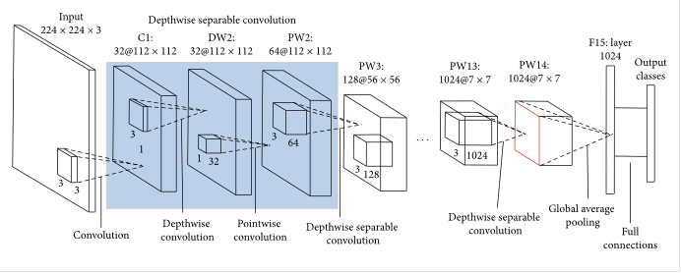
Neural Network Architecture
MobileNet Architecture
Notes:
Previously we have used the Alex Net architecture, however since then, we’ve found that the MobileNet Architecture was lighter and had performed better in our application. MobileNet is a class of CNN that was open-sourced by Google, and therefore, provides an excellent candidate for training our classifiers that are insanely small and insanely fast.

Slide 7
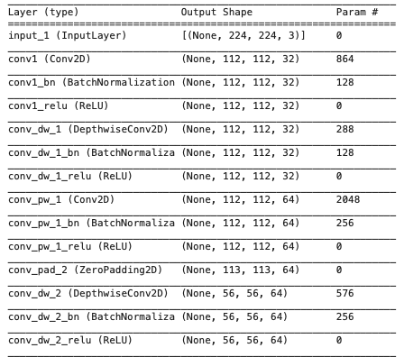
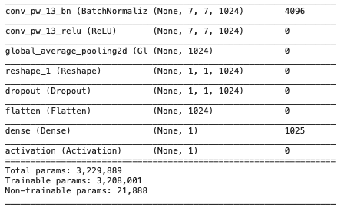
Neural Network Architecture
....
Notes:
Our latest model has 13 Depthwise Convolution layers and 13 Pointwise convolution layers. it also has a total of about 3 million and 230 parameters.
In this model, we used “binary_crossentropy” to define the loss function and use “accuracy” as the error metric.

Slide 8
Baseline Model Metrics
 | Training | Validation
Accuracy | 1.000 | 0.990
Loss | 0.659E-04 | 0.0671
Notes:
At epoch 7, training loss is 6.4966e-04, training accuracy is 1.0000, validation loss is 0.0671, and validation accuracy is 0.9900. We theorize that the success in the model performance is largely due to the simplicity of determining our labels eyes open or closed, yawn or no_yawn. Overall we have very happy with these results.

Slide 9
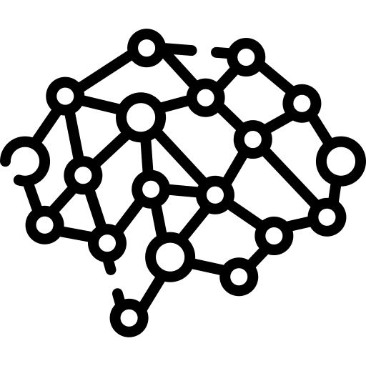
Future Work - Dataset and Networks
Facial Expression Recoginition
Improve facial region cropping
Improve latency
Notes:
There is always room for improvement. Our model can be further developed to become more complex. One possibility would be to include more driver states such as aggravated or distracted driving in addition to drowsiness driving.
We can also improve the image cropping and better focus on the facial regions. One possibility is the MTCNN or the Multitask cascaded convolution neural network. MTCNN is a framework that would improve face detection and face alignment using three stages of convolutional networks
Furthermore, we can improve the latency ranges, currently it is about 0.5 to 1 second in our live testing. Since this part of the project is not closely related to the core content of this course, we decided not to devote too much energy into optimizing latency.

Slide 10

Thank You

